Slide 1
T-COFFEE
A novel method
for
Multiple Sequence Alignements
Dr. Muhammad Tahir
Assistant Professor
CUI, Attock Campus
Some slides are taken from: Cédric Notredame

Slide 2
.
T-Coffee is a multiple sequence alignment program.
It will allow you to combine results obtained with several alignment methods.
It can align up to 500 sequence.
T-Coffee can be used to compare alternative alignment
T-Coffee maximum file size of 1 MB.
Clustal Omega maximum file size of 4 MB

Slide 3
T-Coffee
• Tree-based
Consistency
Objective
Function
For
alignment Evaluation.
• It is suitable for small alignments.
• Compare all the sequences two by two, producing a
global alignment and a series of local alignments (using
lalign).
• Then combine all these alignments into a multiple
alignment.

Slide 4
T-Coffee
T-Coffee is a consistency-based MSA tool that attempts to mitigate the pitfalls of progressive alignment methods.
It uses a progressive approach like ClustalW.
But it has advanced features to evaluate the quality of the alignments and some capacity for identifying occurrence of motifs.

Slide 5
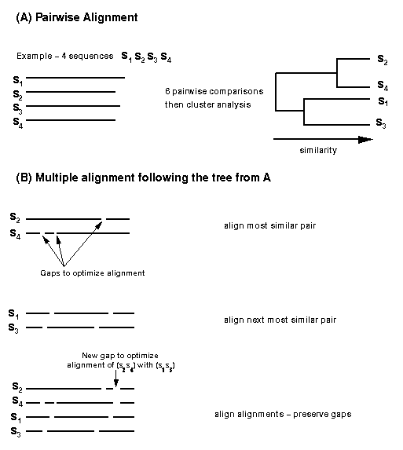

Slide 6
T-Coffee
A collection of tools for Computing, Evaluating and Manipulating Multiple Alignments of DNA, RNA, Protein Sequences and Structures
URL: https://tcoffee.vital-it.ch/apps/tcoffee/index.html
OR
http://www.ebi.ac.uk/Tools/msa/tcoffee/

Slide 7



Potential Uses of A Multiple Sequence Alignment?
chite ---ADKPKRPLSAYMLWLNSARESIKRENPDFK-VTEVAKKGGELWRGLKD
wheat --DPNKPKRAPSAFFVFMGEFREEFKQKNPKNKSVAAVGKAAGERWKSLSE
trybr KKDSNAPKRAMTSFMFFSSDFRS----KHSDLS-IVEMSKAAGAAWKELGP
mouse -----KPKRPRSAYNIYVSESFQ----EAKDDS-AQGKLKLVNEAWKNLSP
***. ::: .: .. . : . . * . *: *
chite AATAKQNYIRALQEYERNGG-
wheat ANKLKGEYNKAIAAYNKGESA
trybr AEKDKERYKREM---------
mouse AKDDRIRYDNEMKSWEEQMAE
* : .* . :
Extrapolation
Phylogeny
Multiple Alignments Are CENTRAL to MOST Bioinformatics Techniques.
Motifs/Patterns
Struc. Prediction
Profiles

Slide 8


Why Is It Difficult To Compute A multiple Sequence Alignment?
A CROSSROAD PROBLEM
BIOLOGY: What is A Good Alignment
COMPUTATION What is THE Good Alignment
chite ---ADKPKRPLSAYMLWLNSARESIKRENPDFK-VTEVAKKGGELWRGLKD
wheat --DPNKPKRAPSAFFVFMGEFREEFKQKNPKNKSVAAVGKAAGERWKSLSE
trybr KKDSNAPKRAMTSFMFFSSDFRS----KHSDLS-IVEMSKAAGAAWKELGP
mouse -----KPKRPRSAYNIYVSESFQ----EAKDDS-AQGKLKLVNEAWKNLSP
***. ::: .: .. . : . . * . *: *

Slide 9
Why Is It Difficult To Compute A multiple Sequence Alignment ?
BIOLOGY
COMPUTATION
CIRCULAR PROBLEM....
Good
Good
Sequences
Alignment

Slide 10

Progressive Alignment
Dynamic Programming Using A Substitution Matrix

Slide 11
T-Coffee Algorithm
Generating a primary library of alignments
Derivetion of the primary library weights
Combination of the libraries
Extending the library
Progressive alignment strategy

Slide 12
ClustalW Primary Library (Global)
Lalign Primary Library (Local)
Weighting
Primary Library

Slide 13
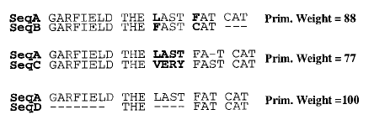
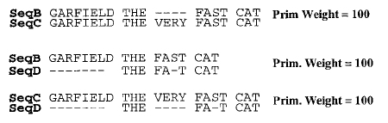
Primary Library

Slide 14
ClustalW Primary Library (Global)
Lalign Primary Library (Local)
Weighting
Primary Library
Extension
Extended Library

Slide 15


Extended Library
Weight(A-C-B)
= min( Weigh(A-C), Weight(B-C) )
= min( 77, 100 ) = 77
A
Weight(A-D-B)
= min( Weight(A-D), Weight(B-D) )
= min( 100, 100 ) = 100

Slide 16
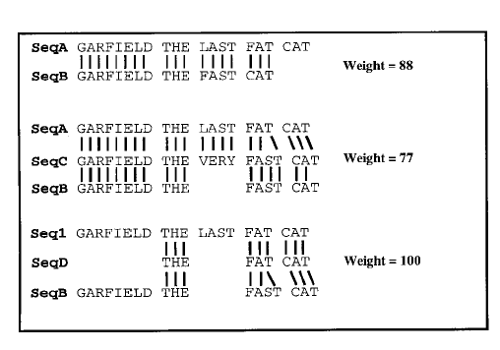
Extended Library
SeqA: GARFIELD THE LAST FAT CAT
SeqB: GARFIELD THE FAST CAT
SeqA: GARFIELD THE LAST FAT CAT
A
SeqB: GARFIELD THE FAST CAT

Slide 17
Extended Library
SeqA: GARFIELD THE LAST FAT CAT
SeqB: GARFIELD THE FAST CAT
SeqA: GARFIELD THE LAST FAT CAT
A
SeqB: GARFIELD THE FAST CAT

Slide 18
ClustalW Primary Library (Global)
Lalign Primary Library (Local)
Weighting
Primary Library
Extension
Extended Library
Progressive Alignment
Multiple Alignment Information

Slide 19
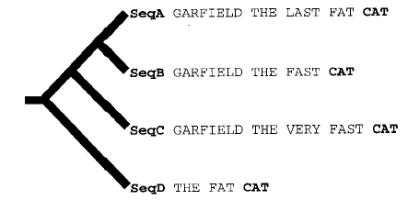
Progressive Assignment

Slide 20
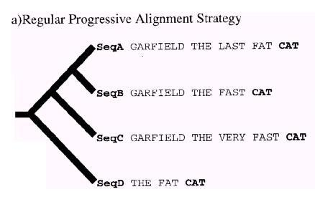
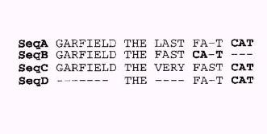
Progressive Alignment Principle and its Limitations…

Slide 21
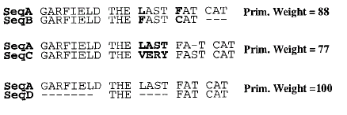
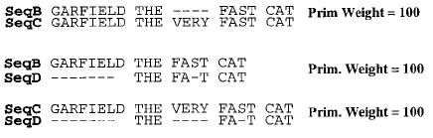
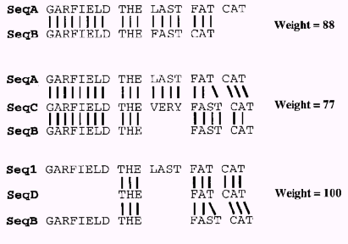
The Extended Library Principle…

Slide 22
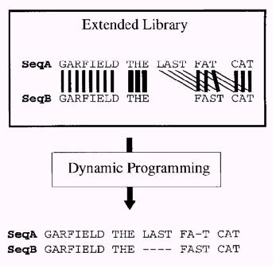
The Extended Library Principle…

Slide 23
How Long Does it Take

Slide 24
Complexity Analysis
complexity of the whole procedure:
O(N²L²) + O(N³L) + O(N³) + O(NL²)
O(N²L²): computation of the pair-wise library
O(N³L): computation of the extended pair-wise library
O(N³): computation of the NJ tree
O(NL²): computation of the progressive alignment
N sequences that can be aligned in a multiple alignment of length L

Slide 25
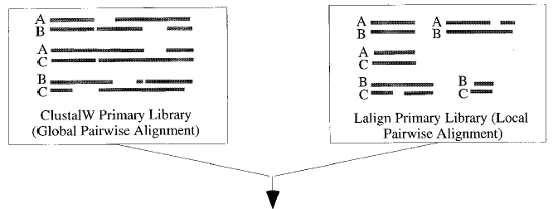
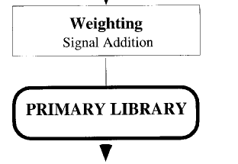
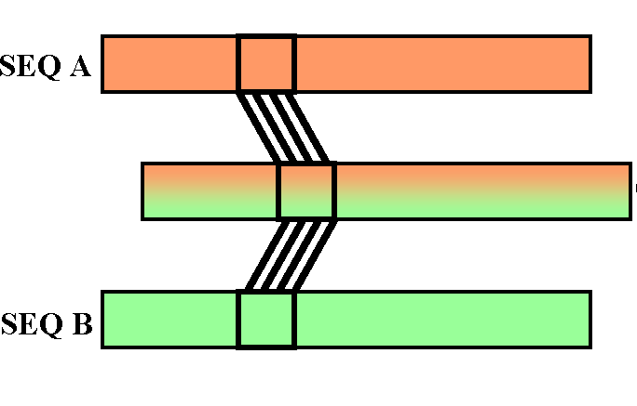
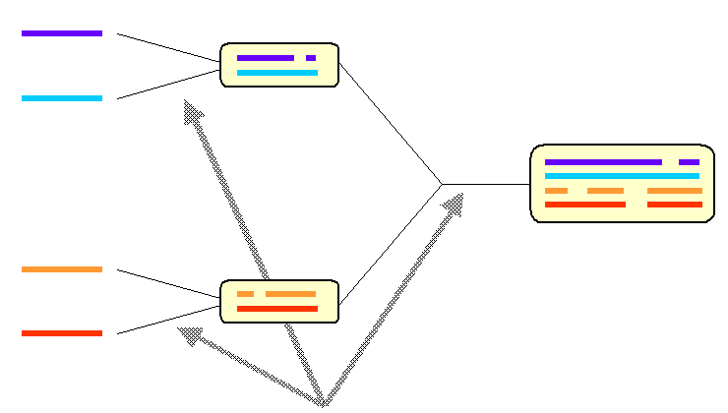
Primary Lib: O(N²L²)
Extension:O(N³L²)
Tree :O(N²L²)+O(N³)
Aln :O(NL²)

Slide 26
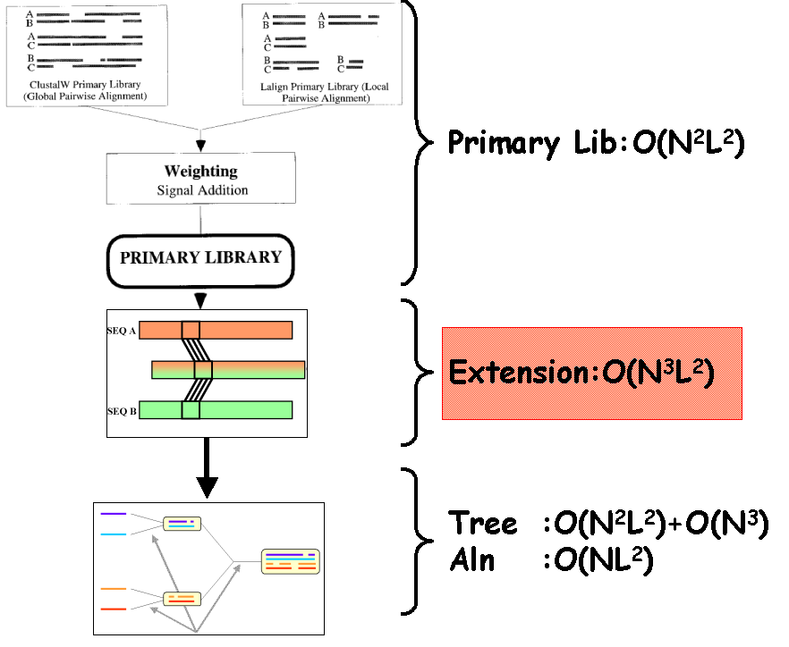
N times slower than ClustalW

Slide 27
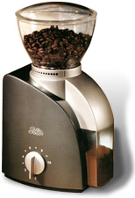
Mixing Heterogenous Information With T-Coffee
Local Alignment
Global Alignment
Multiple Alignment
Specialist
Structural
Multiple Sequence Alignment

Slide 28
Running T-Coffee ONLINE

Slide 29
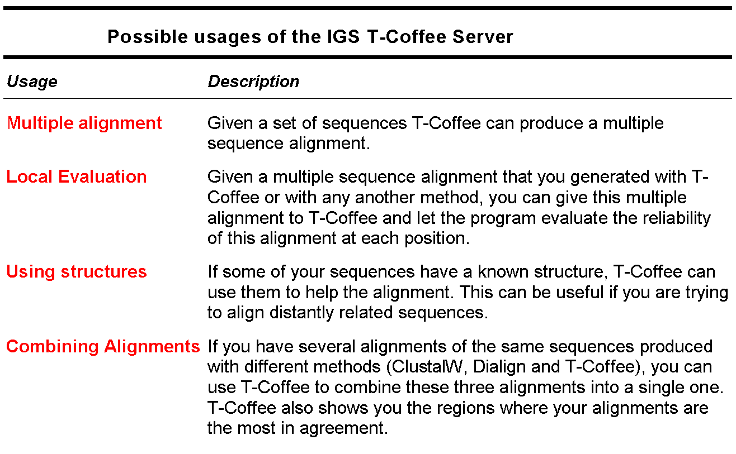
The T-Coffee Server

Slide 30
1.
2.
Go to http://www.ebi.ac.uk/Tools/msa/tcoffee/ in your browser.
Enter
your input sequence.
(eg:
iron
superoxide
dismutase
(FeSODs) of Oryza sativa subsp. indica (B8B2C9), Arabidopsis
thaliana
(P21276),
Escherichia
coli
(P0AGD3),
Nostoc
punctiforme (B2IZB2) and Synechococcus elongatus strain PCC
7942 (P18655))
Go to choose file and give your input sequence in any valid format
3.
(GCG,
FASTA,
EMBL,
GenBank,
PIR,
NBRF
or
UniProtKB/Swiss-Prot format).
Similarly give other input sequences (There is currently a limit of
500 sequences and 1MB of data).
4.
5.
Click
on
‘more
options’ button
to
set
the
alignment
options.
Matrix -used when generating the
MSA. Default value is: ‘None’,
Other
options:
BLOSUM and
PAM.
Order
-in which
the
sequences appear in the final alignment. Default value is: ‘aligned’
Other option: ‘input’
Enter submit.
6.

Slide 31
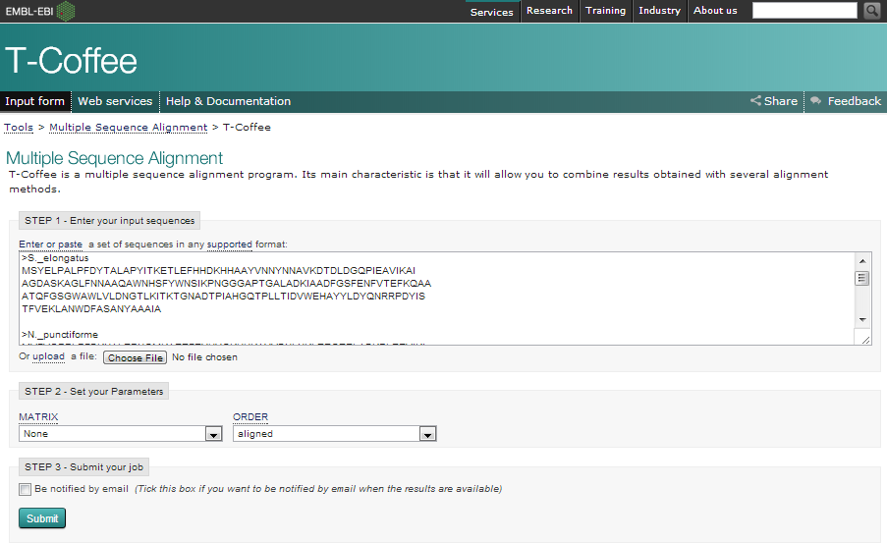
T-Coffee Multiple Sequence Alignment interface at EBI
(http://www.ebi.ac.uk/Tools/msa/tcoffee/)

Slide 32
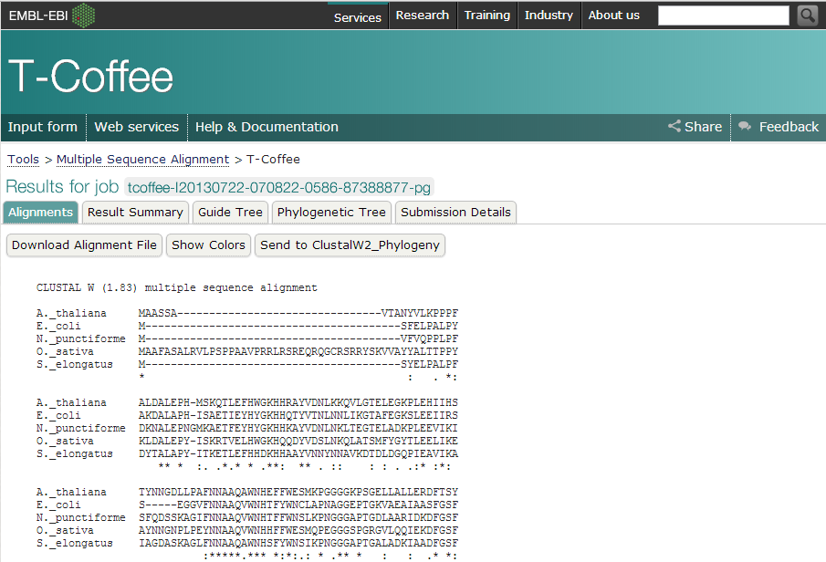
MSA in aln format

Slide 33
• ‘Alignment’ tab (default) -shows the alignment in aln format.
• By default an alignment will display the following symbols that
denote the degree of conservation observed in each column:
"*" -residues or nucleotides in that column are identical in all sequences in the alignment.
":" -conserved substitutions have been observed.
"." -semi-conserved substitutions are observed.
• ‘Download Alignment File’ - to download the alignment in .aln
format.
• ‘Show Colors’, -the alignment will be shown in colour.
• ‘ClustalW2_Phylogeny’- MSA can be directly parsed to
ClustalW2 Phylogeny program. This allows the user to control the method of tree construction.

Slide 34
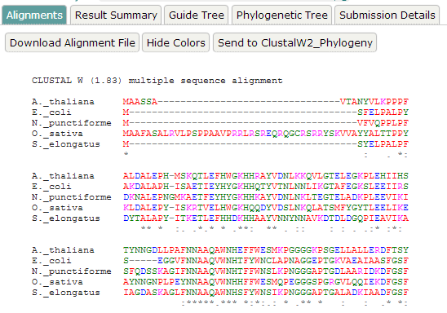
Alignment displayed in colour based on their physicochemical properties

Slide 35
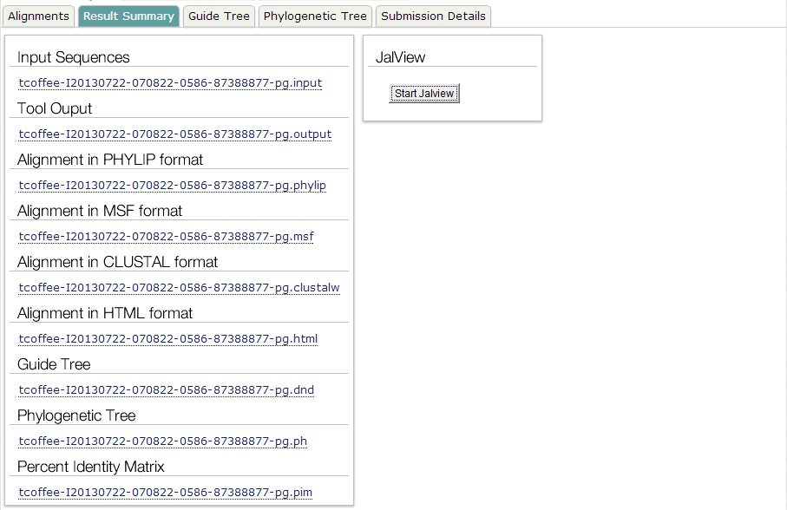
Result summary along with the JalView trigger button

Slide 36
•
‘Result
Summary’
-displays
sequences
the
for
result
files
comprising
the
input
the
is
alignment
(.input),
created
format
tool
output
(.output), which
a
log
file
during
the
alignment,
alignment
in HTML
(.html),
alignment
in
PHYLIP
format
(.phylip), alignment
in CLUSTAL format (.clustalw),
alignment in
MSF
format
(.msf) and
guide
tree
(.dnd) that contains
the information for building the
cladogram or phylogram.
•
‘Start JalView’ under JalView -triggers JalView, a
Java based editor in new window. This requires Java program to be preinstalled.

Slide 37
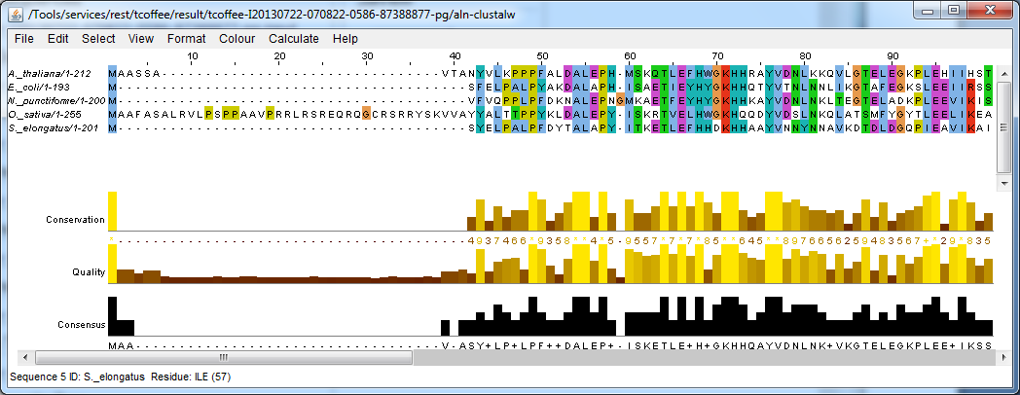
JalView editor

Slide 38
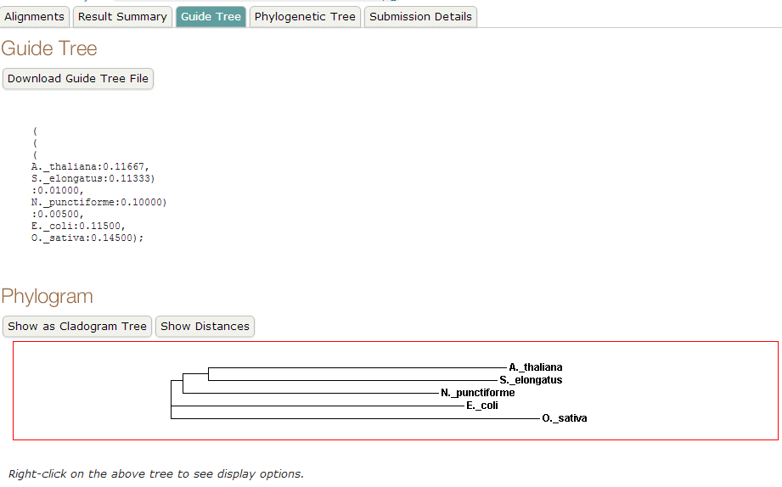
Guide tree generated during alignment process

Slide 39
• Phylogram
-Branching
diagram
(tree)
assumed
to
be
an
estimate of a phylogeny.
-Branch lengths are proportional to the inferred evolutionary change.
amount
of
• Cladogram
-Branching
diagram
(tree)
assumed
to
be
an
estimate of a phylogeny where the
branches are of equal
length, thus cladograms show common ancestry, but do
not
indicate
the
amount
of
evolutionary
"time"
separating taxa.

Slide 40
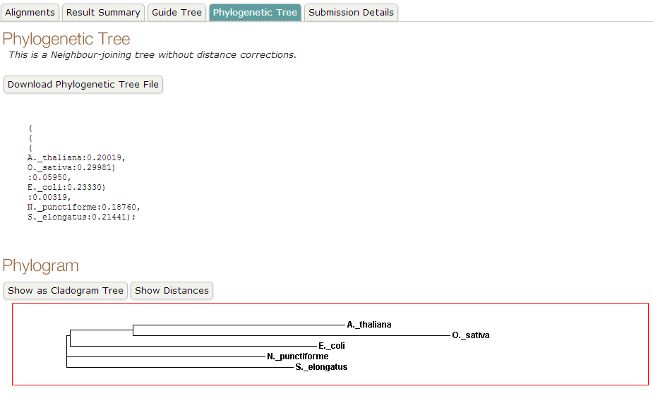
Neighbour-joining tree without correcting the distances

Slide 41
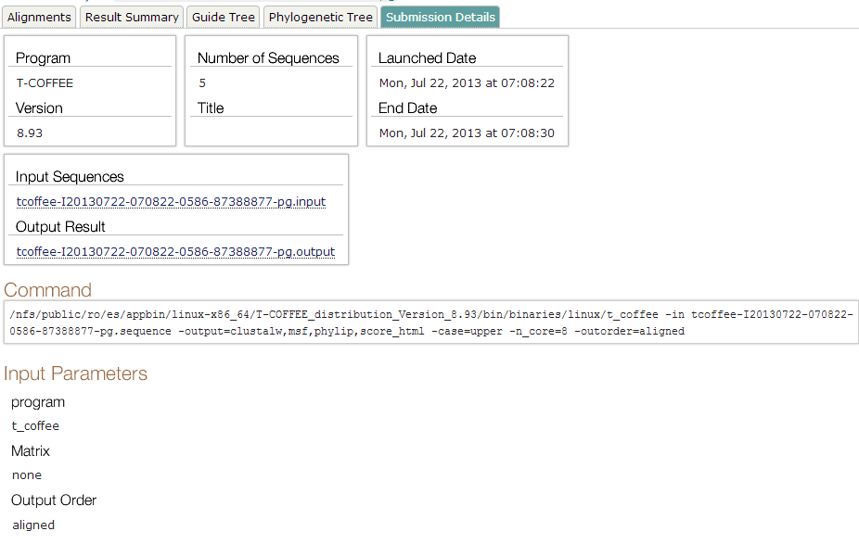
submission details of the alignment

Slide 42
END

